Slide 1
Retirement Plan Access and Participation of Marylanders
Presented to:
Governor’s Task Force to Ensure Retirement Security for All Marylanders
Michael C. Rubenstein, DLS
Hillary Huffer, DLLR
November 19, 2014

Slide 2
Outline of Presentation
Introduction
Data Sources
Definitions
Overview of retirement plan types
National trends in employer-based retirement plan participation
Retirement plan access and participation in 2014
Maryland Quick Facts
Access of Marylanders
Conclusion

Slide 3
Notes on the Data
Historical data is based on retirement plan filings with the U.S. Department of Labor; change in definition of “active participant” does not allow for consistent reporting beyond 2004
National Compensation Survey (2014 national data) does not provide reliable state-level data
Current Population Survey (2014 Maryland data) captures only Maryland residents, not Maryland workers.

Slide 4
Access vs. Participation
Access: Employer offers a retirement plan to its employees
Participation: Employee elects to participate
Take Up: Rate at which employees who have access to a plan choose to participate

Slide 5
Defined Benefit (DB) Plans
Purpose: To provide a guaranteed postretirement annuity for the remainder of a retiree’s (or beneficiary’s) life
Benefit: Annuity determined by a formula that includes employee’s final average compensation and years of service to provide a guaranteed lifetime benefit
Funding: Actuarially funded in shared risk pool, with assets provided by employer and/or employee contributions and investment returns

Slide 6
Defined Contribution (DC) Plans
Purpose: To provide a vehicle for individual tax-deferred retirement savings in an employer-sponsored plan
Benefit: Account balance at the time of an individual’s retirement, payable as a lump sum, periodic distributions, or annuity
Funding: Employer and/or employee contributions and investment returns held in individual accounts

Slide 7
DB and DC Both Have Advantages and Disadvantages
 | Defined Benefit | Defined Contribution
Eligibility | Condition of employment | Optional participation
Longevity Risk | Shared | Individual
Investment risk | Assumed by plan sponsor | Assumed by employee
Employer contribution | Yes | Optional; often in the form of an employer match
Employee contribution | At employer’s discretion | At employee’s discretion
Tax deferred? | Federal only (MD) | State and federal
Portability | Limited or none | Yes

Slide 8
Trends in National Participation
The number of workers participating in retirement plans increased steadily since 1975.
The number of workers participating in defined benefit plans has declined gradually since 1984.
The number of workers participating in defined contribution plans has increased substantially since 1975.

Slide 9
Retirement Plan Access and Participation for Private Sector Workers: 2014
 | All Benefits |  |  | Defined Benefit |  |  | Defined Contribution
 | Access | Participation |  | Access | Participation |  | Access | Participation
All workers | 65% | 48% |  | 19% | 16% |  | 60% | 42%
Middle Atlantic | 64 | 52 |  | 25 | 23 |  | 56 | 42
Union | 92 | 83 |  | 71 | 66 |  | 56 | 45
Nonunion | 62 | 45 |  | 13 | 11 |  | 61 | 42
Lowest wage quartile | 38 | 18 |  | 5 | 3 |  | 36 | 16
Highest wage quartile | 85 | 75 |  | 36 | 32 |  | 80 | 66
1 to 49 workers | 45 | 32 |  | 8 | 7 |  | 47 | 32
50 to 99 workers | 63 | 43 |  | 12 | 11 |  | 58 | 38
100+ workers | 82 | 64 |  | 31 | 27 |  | 75 | 54

Slide 10
Maryland Quick Facts
Population approximately 5.9 million
Number of Primary Jobs of workers living in Maryland 2.5 million
Total Non-farm employment in Maryland 2.6 million
Private nonfarm establishments more than 130,000
Approximately 2 million people live and work primary jobs in Maryland
Many establishments in Maryland are small to medium in size

Slide 11
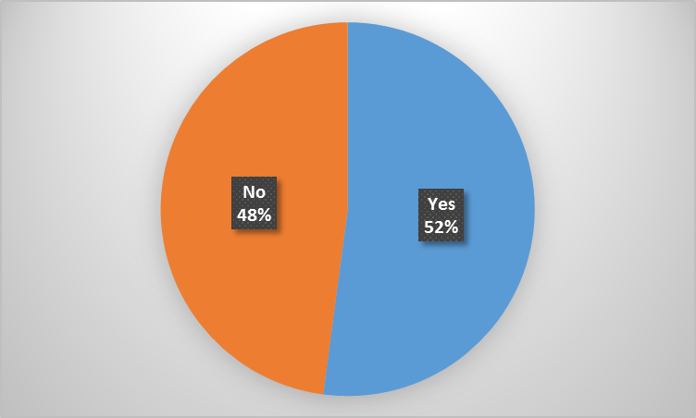
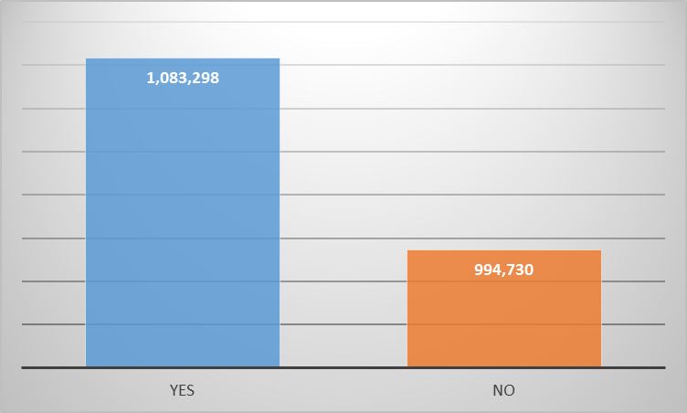
Access for Marylanders

Slide 12
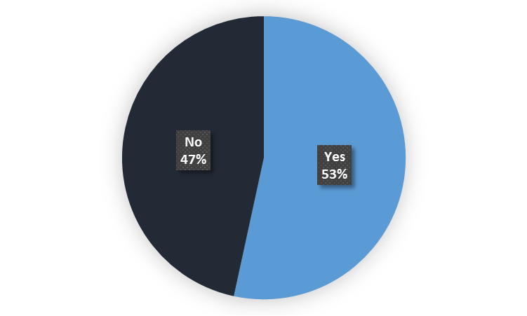
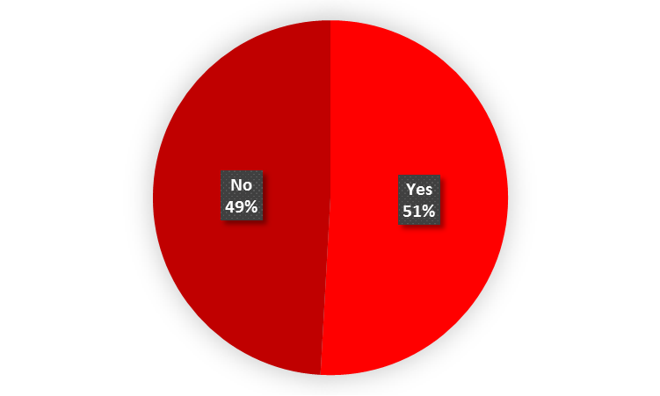
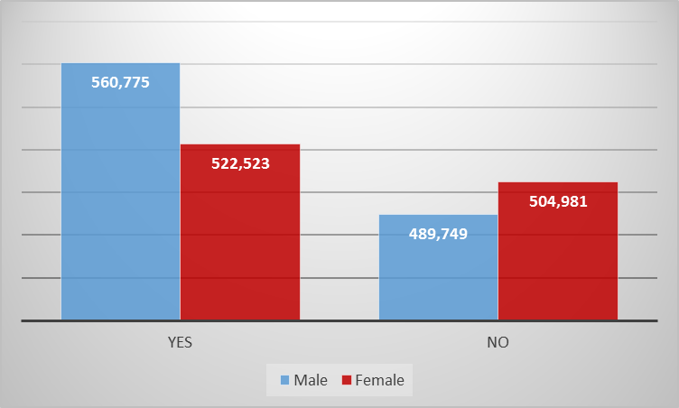
Access by Gender

Slide 13
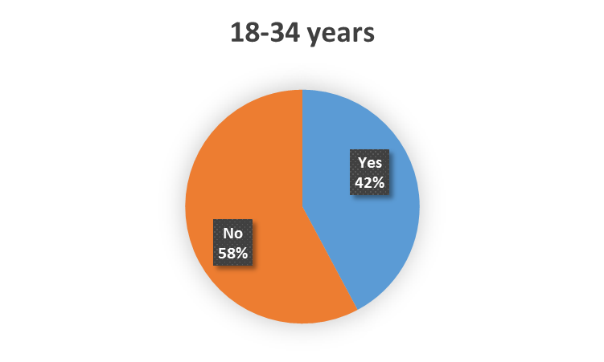
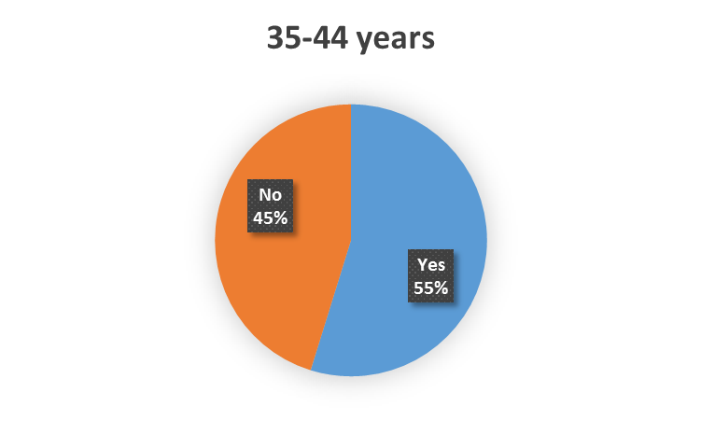
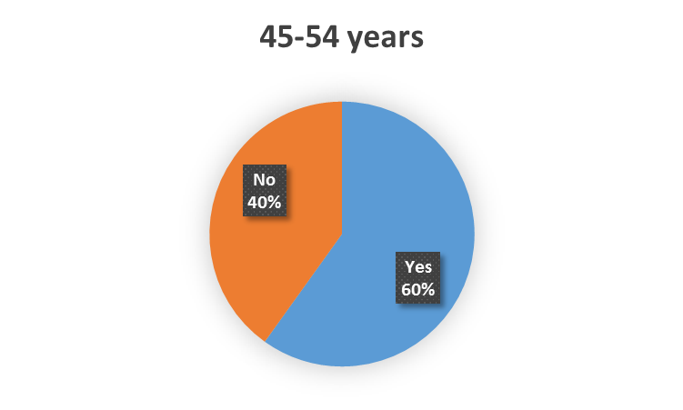
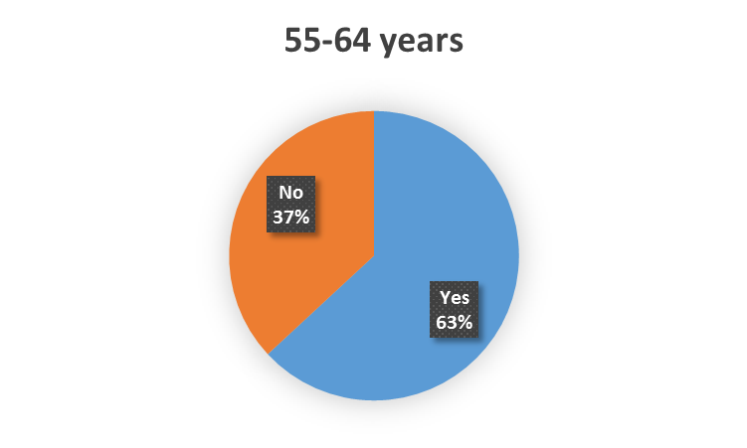
Access by Age

Slide 14
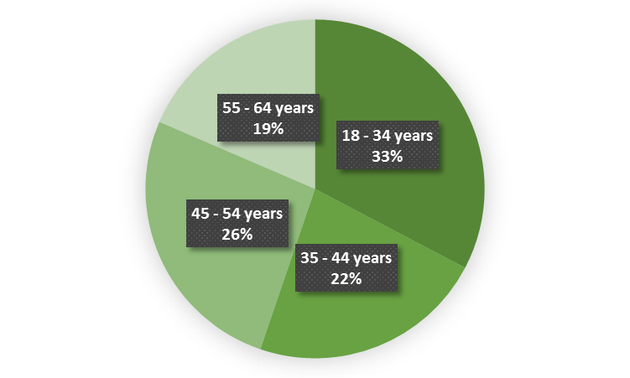
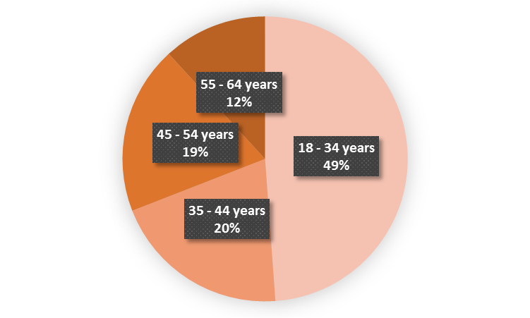
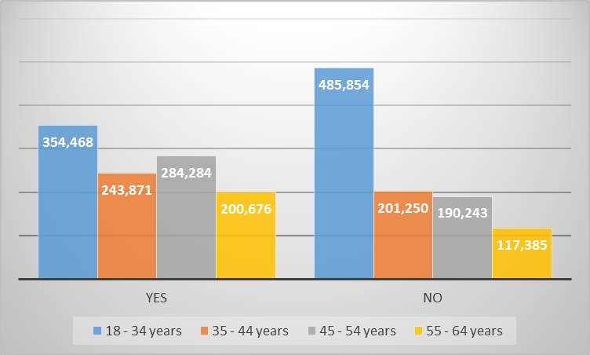
Access by Age

Slide 15
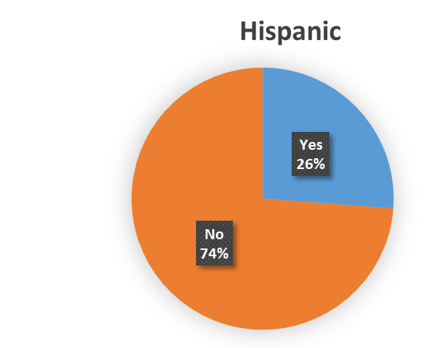
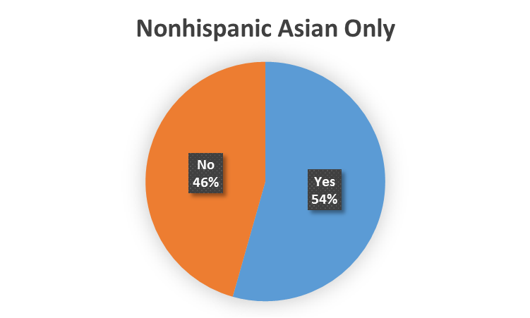
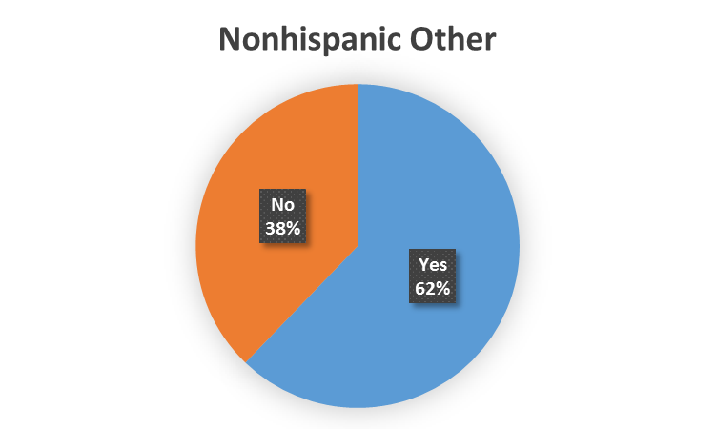
Access by Race/Ethnicity

Slide 16
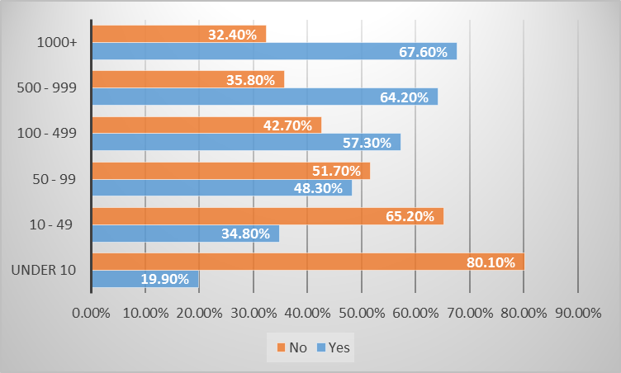
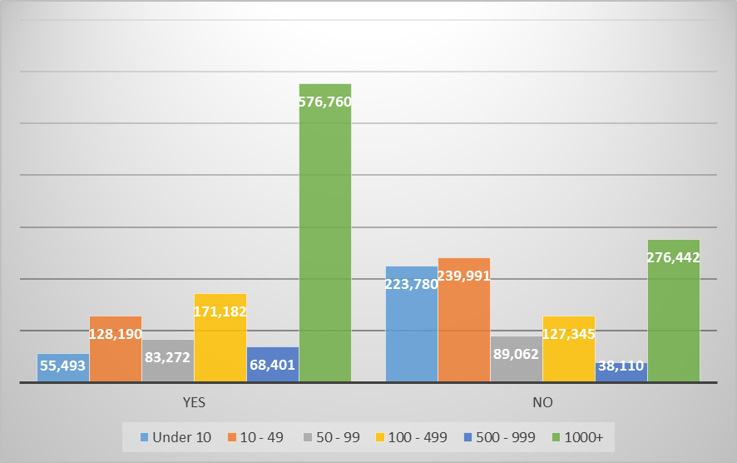
Access by Employer Size

Slide 17
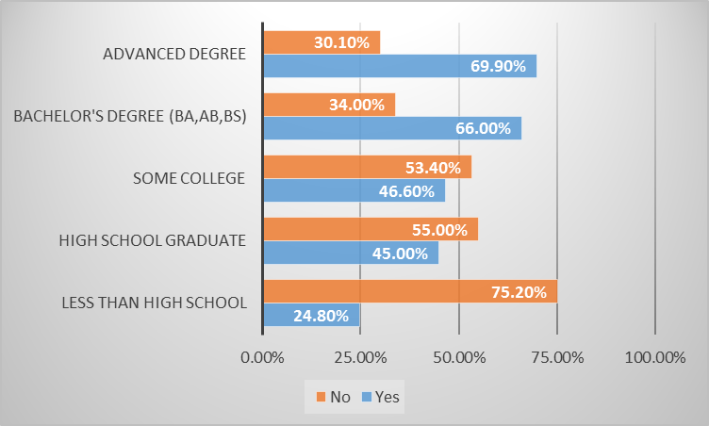
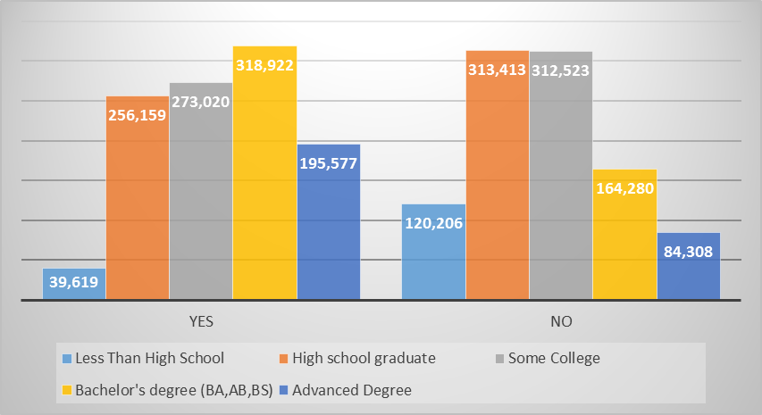
Access by Educational Attainment

Slide 18
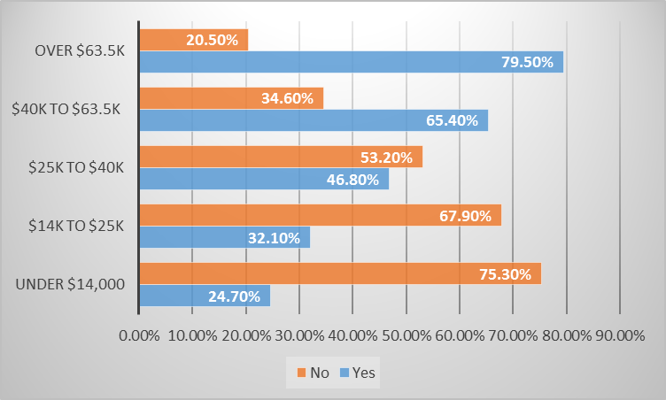
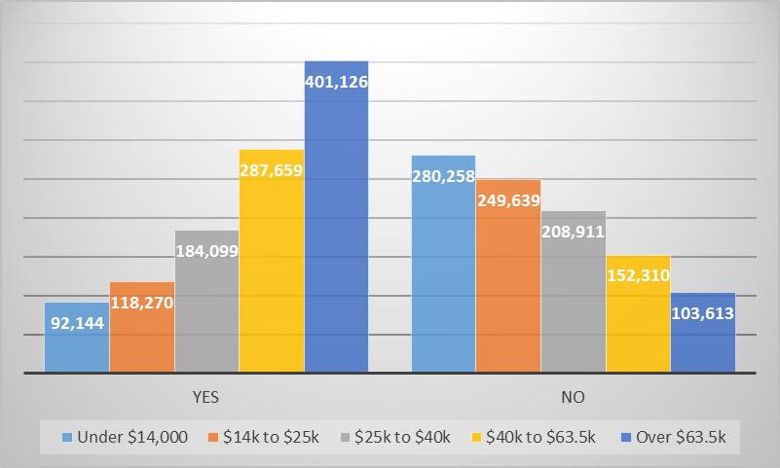
Access by Earnings Quintile

Slide 19
Access of Marylanders Summary
A little more than half of Marylanders have access to an employer provided retirement plan
This access is not equal across:
Gender
Race/ethnicity
Age
Educational attainment
Employer size
Earnings Quintile

Slide 20
Thank you
Michael C. Rubenstein, DLS
Michael.Rubenstein@mlis.state.md.us
Hillary Huffer, DLLR
Hillary.Huffer@Maryland.gov

Slide 21
Back-up slide

Slide 22
Back-up slide
Total establishments | 1-4 | 5-9 | 10-19 | 20-49 | 50-99 | 100-249 | 250-499 | 500-999 | 1000 or more
134,305 | 71,060 | 25,479 | 17,607 | 12,338 | 4,504 | 2,459 | 552 | 184 | 122

