Slide 1
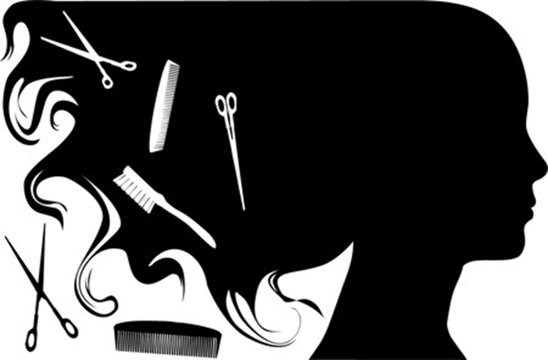
.
THE MARYLAND BOARD OF COSMETOLOGISTS APPRENTICESHIPS

Slide 2
APPRENTICE HOURS
APPRENTICE COSMETOLOGIST: SPONSORED BY A SENIOR COSMETOLOGIST. ALLOWED ONE 2-YEAR ORIGINAL LICENSE AND ONE 2-YEAR RENEWAL. MUST COMPLETE 24 MONTHS OF TRAINING.
APPRENTICE HAIRSTYLIST: SPONSORED BY A SENIOR COSMETOLOGIST OR TWO-YEAR LICENSED LIMITED HAIRSTYLIST. ALLOWED A 2-YEAR ORIGINAL LICENSE, NO RENEWALS. MUST COMPLETE 15 MONTHS OF TRAINING.
APPRENTICE ESTHETICIAN: SPONSORED BY A SENIOR COSMETOLOGIST OR TWO-YEAR LICENSED LIMITED ESTHETICIAN. ALLOWED A ONE-YEAR ORIGINAL LICENSE AND ONE ONE-YEAR RENEWAL. MUST COMPLETE 12 MONTHS OF TRAINING.
APPRENTICE NAIL TECHNICIAN: SPONSORED BY A SENIOR COSMETOLOGIST OR TWO-YEAR LIMITED NAIL TECHNICIAN. ALLOWED A ONE-YEAR ORIGINAL LICENSE, NO RENEWALS. MUST COMPLETE EIGHT MONTHS OF TRAINING.

Slide 3
CHANGING LICENSE CATEGORY
ONCE YOUR LICENSE IS ISSUED, & YOU START SUBMITTING YOUR HOURS, IF YOU DECIDE TO CHANGE YOUR LICENSE CATEGORY YOU WILL NOT RECEIVE HOURS FOR YOUR PAST TRAINING.
YOU WILL HAVE TO START ALL OVER!
Contact Barbers.cos@Maryland.gov for assistance

Slide 4

MONTHLY REPORTS
ONLY THE SPONSOR IS RESPONSIBLE FOR SUBMITTING THE APPRENTICES MONTHLY REPORT
If a sponsor has more than 1 apprentice on their account, the sponsor must email (#4).
THE REGULATIONS AND STATUES REQUIRE MONTHLY APPRENTICE REPORTS TO BE
ONLINE (Sponsor Certification for Apprentice Training) (Right click, Open Hyperlink)
Click “sponsor certification for Apprentice training
Enter the sponsors registration number & password
EMAIL Barbers.cos@Maryland.gov , for assistance
MONTHLY REPORTS MUST BE SUBMITTED WITHIN 90 CALENDAR DAYS TO BE CONSIDERED VALID.
LATE REPORTS WILL NOT BE COUNTED AFTER 90 CALENDAR DAYS WITHOUT PROOF OF WORK EXPERIENCE:
TAX DOCUMENTATION OR A NOTARIZED LETTER FROM EMPLOYER.

Slide 5
Completion of Apprenticeship
Once the Apprentice completes the Apprenticeship, the apprentice is no longer able to renew their license. Once the apprentice license expires, the apprentice is no longer allowed to work in the shop or under their sponsor.
Maryland Board of Cosmetology licensee, Click Here to review the "Candidate Information Bulletin (CIB)" for additional details for preparing, applying, and taking the test.
You will need to submit the letter that we will email you displayed on the next slide.
For any additional questions or concerns pertaining to PSI, (general questions & concerns, test scores/results, application processing & fees, scheduling, etc.) please email at Cosmetologoy@psionline.com or mdcosapp@psionline.com. You may also call 1-800-367-1565 or 855-898-0714.

Slide 6
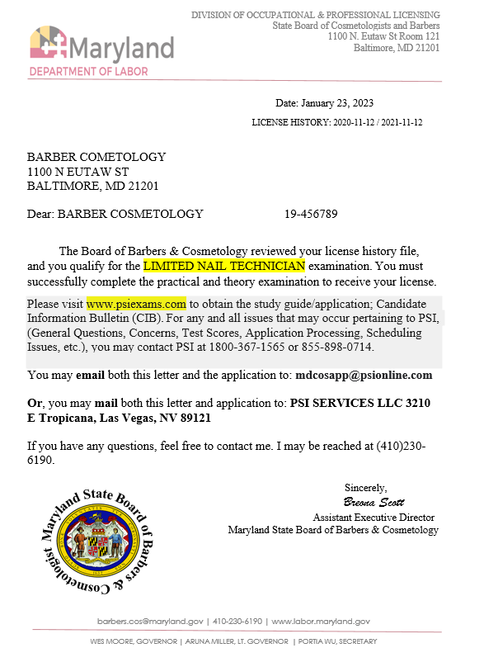


COMPLETION OF APPRENTICESHIP
QUALIFIED LETTER FROM THE BOARD

Slide 7
PSI TESTING COMPANY
WEBSITE- Www.Psiexams.COM (CIB APPLICATION PG 38-42) (SPONSOR NEEDS TO COMPLETE PG-40 Apprentice Training Certification)
Cosmetology Theory Examination Reference Materials -Milady’s Standard Textbook Of Cosmetology 2016 & Salon Fundamentals Cosmetology, 3rd Edition, 2014
Reference To Study- Maryland Law And Regulations (Law and Regulations - Maryland Board of Cosmetologists - Division of Occupational and Professional Licensing)
Theory Test Is Given In Every Language (Paid Interpreters)
Also Download The Candidate Information Bulletin In Those Languages
NO LIVE MODELS, MANNEQUINS ONLY.
FOR ANY AND ALL ISSUES THAT MAY OCCUR PERTAINING TO PSI, (GENERAL QUESTIONS, CONCERNS, TEST SCORES, APPLICATION PROCESSING, SCHEDULING ISSUES, ETC) EMAIL COSMETOLOGY@PSIONLINE.COM OR BARBER@PSIONLINE.COM. YOU MAY ALSO CALL 1800-367-1565 OR 855-898-0714.

Slide 8
EXAM FEES
APPLICANTS FOR COSMETOLOGIST, ESTHETICIAN, NAIL TECHNICIAN, AND SENIOR COSMETOLOGIST MUST PASS AN EXAMINATION IN ORDER TO QUALIFY FOR A LICENSE.
COSMETOLOGIST: PRACTICAL AND THEORY - $79; PRACTICAL ONLY - $49; THEORY ONLY - $49
NAIL TECHNICIAN: PRACTICAL AND THEORY - $79; PRACTICAL ONLY - $49; THEORY ONLY - $49
ESTHETICIAN: PRACTICAL AND THEORY - $79; PRACTICAL ONLY - $49; THEORY ONLY - $49
SENIOR COSMETOLOGIST: THEORY - $49

Slide 9
SUGGESTED SUPPLY LIST FOR ALL LICENSEES
The following list is meant to be a suggested list. Candidates are responsible for bringing all necessary supplies/equipment needed to perform all services. Review the practical examination content outlines to ensure you bring all supplies/equipment you need to perform these services.
PRE EXAM SET UP (All exams)
(THESE ITEMS SHOULD BE IN A ZIP LOCK BAG LABELED: “PRE SANITIZED”)
• Disinfectant (Labeled: EPA disinfectant) • Hand sanitizer (Labeled: Hand Sanitizer) • Paper towels • Trash bag labeled trash/waste • Spray bottle with water labeled water • Blood Exposure Kit /First Aid Kit
OTHER ITEMS TO BRING
• Plain colored smock (Highly recommended, but not mandatory) • Cosmetology, Hair Stylist, Nail Technician exam types will use mannequins and or hand mannequins. • Mannequin stand and/or extender • Esthetician exam types will use models, as described above.

Slide 10
COSMETOLOGIST SUPPLY LIST
THERMAL CURLING SERVICE
• Towel • Tissue/neck strip • Curling iron • Combs • Clippies • Styling aids labeled as Styling aid (non aerosol) Optional
HAIR REMOVAL — EYEBROW TWEEZING & WAXING
• Mock product labeled as Antiseptic • Disposable gloves • Tweezers • Cotton/tissue • Mock product labeled as Astringent • Mock wax product (i.e. honey, petroleum jelly) labeled as wax • Fabric strips
HAIRCUTTING SERVICE
• Neckstrip • Cape • Spray water bottle • Combs • Razor • Shears/Scissors • Clips
BLOOD EXPOSURE SERVICE
• First aid kit • Gloves • Adhesive bandage • Mock product labeled as Astringent • Plastic bag
PERMANENT WAVE SERVICE
• Chemical drape • Permanent Rods (minimum of 6) • Towels • End papers • Mock waving solution (i.e. water) Labeled waving solution • Protective cotton • Gloves
CHEMICAL SERVICES
• Towels • Chemical cape • Comb or applicator brush • Disposable gloves • Mock Highlift color product (Labeled:Highlift color) • Mock Color product (Labeled: Color) • Mock Relaxer product (Labeled: Relaxer) • Mock product labeled as Protective cream (i.e. honey, petroleum jelly)
ACRYLIC NAIL APPLICATION
• Cuticle pusher or orangewood sticks • Nail form • Files • Buffers • Nail dehydrator • Primer • Acrylic Powder • Sealed Odorless monomer (If monomer is not sealed or have the manufactures labeled as odorless, the • candidate will not be permitted to use the product • Acrylic nail brush

Slide 11
HAIRSTYLIST SUPPLY LIST
THERMAL CURLING SERVICE
• Towel • Tissue/neck strip • Curling iron • Combs • Clippies • Styling aids labeled as Styling aid (non aerosol) Optional
HAIRCUTTING SERVICE
• Neckstrip • Cape • Spray water bottle • Combs • Razor • Shears/Scissors • Clips
BLOOD EXPOSURE SERVICE
• First aid kit • Gloves • Adhesive bandage • Mock product labeled as Astringent • Plastic bag
PERMANENT WAVE SERVICE
• Chemical drape • Permanent Rods (minimum of 6) • Towels • End papers • Mock waving solution (i.e. water) Labeled waving solution • Protective cotton • Gloves
CHEMICAL SERVICES
• Towels • Chemical cape • Comb or applicator brush • Disposable gloves • Mock Highlift color product (Labeled:Highlift color) • Mock Color product (Labeled: Color) • Mock Relaxer product (Labeled: Relaxer) • Mock product labeled as Protective cream (i.e. honey, petroleum jelly)

Slide 12
ESTHETICIAN SUPPLY LIST
HAIR REMOVAL — EYEBROW TWEEZING & WAXING
• Mock product labeled as Antiseptic • Disposable gloves • Tweezers • Cotton/tissue • Mock product labeled as Astringent • Mock wax product (i.e. honey, petroleum jelly) labeled as wax • Fabric strips
BLOOD EXPOSURE SERVICES
• First aid kit • Gloves • Adhesive bandage • Mock product labeled as Astringent • Plastic bag
FACIAL SKIN CLEANSING
• Head drape • Towel • Mock product labeled as Cleanser • Cotton/tissue • Spatulas
FACE AND NECK MASSAGING
• Mock massage product labeled as massage cream • Towel • Cotton rounds
MASK/PACK & MOISTURIZING SERVICE
• Mock Mask product labeled as mask • Cotton rounds • Mock product labeled as astringent/toner/freshener • Mock product labeled as moisturize

Slide 13
NAIL TECHNICIAN SUPPLY LIST
BLOOD EXPOSURE SERVICES
• First aid kit• Gloves • Adhesive bandage • Mock product labeled as Astringent • Plastic bag
BASIC MANICURE
• Manicure bowl • Water • Emery boards and nail files • Mock product labeled as Cuticle Remover • Spatulas • Cotton-tipped orangewood sticks or cuticle pusher • Manicure brush • Towel • Base Coat • Dark polish • Top Coat • Mock product labeled as Massage cream • Polish remover
NAIL TIP APPLICATION
• Cotton-tipped orangewood sticks or cuticle pushers • Tip Cutters • Nail tips • Files or emery boards • Manicure brush • Buffers • Nail dehydrator • Nail adhesive NAIL WRAP APPLICATION (Nail Technician) • Dehydrator • Scissors • Wrap material • Resin • Resin Accelerator/Catalyst • Buffer • Files
ACRYLIC NAIL APPLICATION
• Cuticle pusher or orangewood sticks • Nail form • Files • Buffers • Nail dehydrator • Primer • Acrylic Powder • Sealed Odorless monomer (If monomer is not sealed or have the manufactures labeled as odorless, the • candidate will not be permitted to use the product • Acrylic nail brush
NAIL WRAP APPLICATION
• Dehydrator • Scissors • Wrap material • Resin • Resin Accelerator/Catalyst • Buffer • Files

Slide 14
DID YOU KNOW?
THERE ARE NO REQUIREMENTS THAT A SPONSOR PAYS AN APPRENTICE OR THAT AN APPRENTICE HAS TO PAY A SPONSOR.
CAN’T WORK WITHOUT SPONSOR, MUST WORK WHEN SPONSOR WORKS.
IF YOU HAVE A LICENSE IN ANOTHER STATE, YOU DO NOT HAVE TO BECOME AN APPRENTICE (unless coming from Connecticut, Florida, Hawaii, Illinois, Nebraska)
SPONSOR CAN TRAIN 2 APPRENTICE AT A TIME
SHOP & INDIVIDUAL LICENSE MUST BE VALID (NOT EXPIRED) IN ORDER FOR HOURS TO BE ACCOUNTED FOR.
IF SPONSOR OWES CHILD SUPPORT, MUST BE RESOLVED BEFORE THEY CAN TRAIN.
IF APPRENTICE OWES CHILD SUPPORT, MUST BE RESOLVED BEFORE THEY CAN MOVE FORWARD WITH APPRENTICESHIP PROGRAM.
IF TAXES ARE UNRESOLVED “TAX LIABILITY”, MUST BE RESOLVED BEFORE MOVING FORWARD (410-649-0633).
IF YOU NO LONGER WANT TO BE TRAINED UNDER YOUR SPONSOR OR YOUR SPONSOR DOESN’T WANT TO TRAIN YOU ANYMORE, YOU CAN CHANGE. YOU WILL NOT LOSE ANY HOURS.
IF THE SALON OWES A CONSENT ORDER FEE THE APPRENTICE WILL NOT RECEIVE ANY CREDIT UNTIL THAT FEE IS PAID

Slide 15
PROHIBITIONS
09.22.02.03 (LAWS AND REGULATIONS)
THE FOLLOWING ACTIVITIES ARE PROHIBITED IN ANY FULL SERVICE OR LIMITED PRACTICE SALON OR IN REGARD TO ANY SALON-SPONSORED SERVICES:
THE PERFORMANCE OF SERVICES OF ANY KIND ON A CLIENT/LICENSEE OR REGISTRANT WHO HAS AN INFECTIOUS OR CONTAGIOUS DISEASE THAT PRESENTS A HAZARD TO OTHERS. ALSO THE SURFACE OF A CLIENT'S SKIN, SCALP, OR NAIL WHERE THE SKIN, SCALP, OR NAIL IS INFLAMED OR WHERE A SKIN INFECTION OR ERUPTION IS PRESENT UNLESS AUTHORIZED BY A PHYSICIAN.
THE REMOVAL OF CORNS, CALLUSES, OR OTHER GROWTHS OF THE SKIN, SUCH AS WARTS, BY CUTTING
THE PRESENCE OF A DOG, CAT, BIRD, OR ANY KIND OF ANIMAL ON THE SALON PREMISES WITH THE EXCEPTION OF GUIDE DOGS FOR THE BLIND.
THE USE OR POSSESSION OF A CREDO BLADE OR A SIMILAR RAZOR-TYPE IMPLEMENT USED TO CUT GROWTHS ON THE SKIN.
COSMETIC TATTOOING (MICRO-BLADING)

Slide 16
ESTHETICIAN PROHIBITIONS
09.22.02.03 (LAWS AND REGULATIONS)
UNLESS AN INDIVIDUAL POSSESSES A VALID AND APPROPRIATE HEALTH OCCUPATION LICENSE ISSUED BY THE MARYLAND DEPARTMENT OF HEALTH:
(1) THE USE OF LASERS, MICRODERMABRASION EQUIPMENT, OR ANY OTHER MECHANICAL DEVICE USED TO REMOVE ONE OR MORE LAYERS OF SKIN
(2) THE USE OF ANY PRODUCT OR METHOD THAT CAUSES TISSUE DESTRUCTION OR PENETRATES THE BLOOD FLUID BARRIER, INCLUDING:
(A) CHEMICAL PEELS
(B) GLYCOLIC ACIDS
(C) COSMETIC TATTOOING (MICRO-BLADING)
There is not a license in Maryland established for eyelashes/ lash extensions/lash lifting with the Board of Cosmetology. You may perform lash services without a cosmetology license. Please be advised that this service includes chemicals that can be very dangerous when used around the eye area causing irritation if it is not done properly.

Slide 17

HAVE A GREAT DAY.

