Slide 1
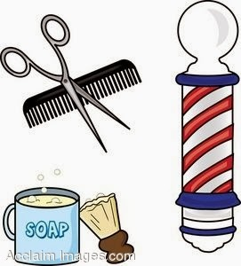
Maryland Board of Barbers Apprenticeship

Slide 2

Apprentice Hours
Apprentice Barber: Sponsored by a Master Barber. Allowed a two-year original license and one two-year renewal. Must complete 2,250 hours of training.
Apprentice Limited Barber stylist: Sponsored by a Master Barber or a Limited Barber Stylist who’s had their license for 15 months. Allowed a two-year original license and one two-year renewal. Must complete 1,650 hours of training.
The MAXIMUM Amount of hours an apprentice can receive a month is 240.

Slide 3

Monthly reports
Only The Sponsor Is Responsible For Submitting The Apprentices Monthly Report.
A SPONSOR CAN HAVE UP TO 3 APPRENTICE AT A TIME. The regulations and statues require monthly apprentice reports to be online or emailed.
Sponsor Certification for Apprentice Training (right click, open hyperlink)
Click “sponsor certification for Apprentice training
Enter the sponsors registration number & password
Email Barbers.cos@Maryland.gov for assistance
Monthly reports must be submitted within 90 calendar days to be considered valid.
LATE REPORTS WILL NOT BE COUNTED AFTER 90 CALENDAR DAYS WITHOUT PROOF OF WORK EXPERIENCE:
TAX DOCUMENTATION OR A NOTARIZED LETTER FROM EMPLOYER.

Slide 4
Completion of Apprenticeship
Once the Apprentice completes the Apprenticeship, the apprentice is no longer able to renew their license. Once the apprentice license expires, the apprentice is no longer allowed to work in the shop or under their sponsor.
The Maryland Board of Barbers licensee, Click Here to review the "Candidate Information Bulletin (CIB)" for additional details for preparing, applying, and taking the test. You will need to submit the letter attached to this email, along with the CIB application.
You will need to submit the letter that we will email you displayed on the next slide.
For any additional questions or concerns pertaining to PSI, (general questions & concerns, test scores/results, application processing & fees, scheduling, etc.) please email at Cosmetologoy@psionline.com or mdcosapp@psionline.com. You may also call 1-800-367-1565 or 855-898-0714.

Slide 5
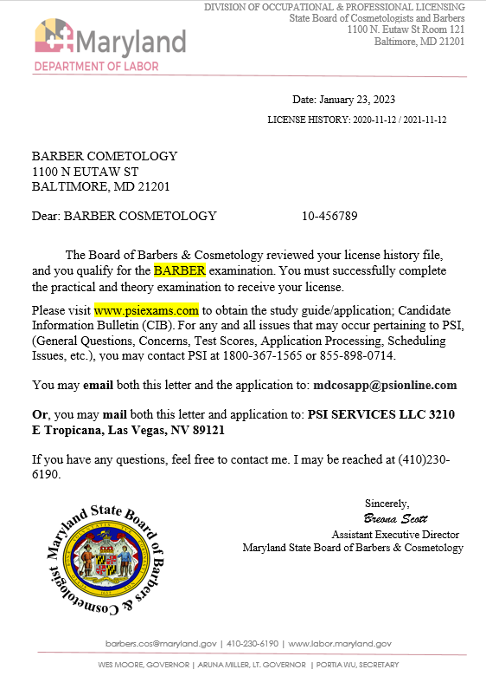
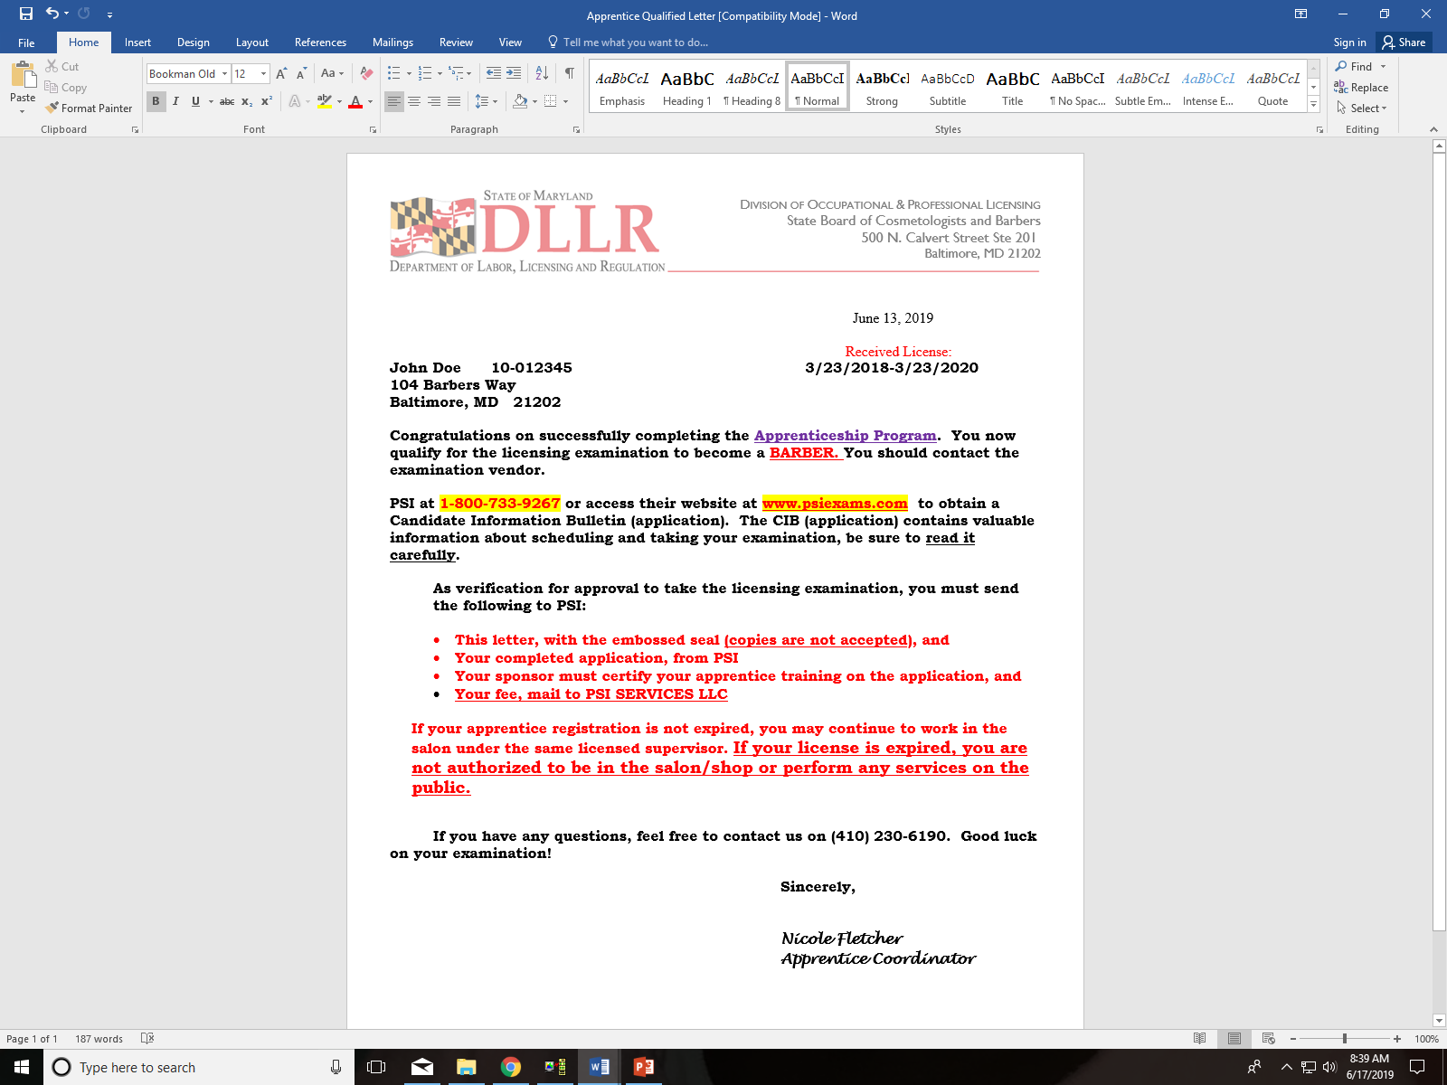
Completion of apprenticeship

Slide 6
PSI TESTING COMPANY
WEBSITE- WWW.PSIEXAMS.COM
Application-Barber Examination Application (right click, open hyperlink)
NO LIVE MODELS, MANNEQUINS ONLY!
(CIB APPLICATION PG 21-25) (SPONSOR NEEDS TO COMPLETE PG-22 APPRENTICE TRAINING CERTIFICATION)
PHONE NUMBER- 1-800-733-9267
RECOMMENDED TEXT- MILADY’S STANDARD PROFESSION BARBERING 2011.
REFERENCE TO STUDY- MARYLAND LAW AND REGULATIONS (HTTPS://WWW.DLLR.STATE.MD.US/LICENSE/LAW/BARBERSLAW.SHTML)
THEORY TEST ALLOWS INTERPRETERS (PAID BY APPRENTICE)
FOR ANY AND ALL ISSUES THAT MAY OCCUR PERTAINING TO PSI, (GENERAL QUESTIONS, CONCERNS, TEST SCORES, APPLICATION PROCESSING, SCHEDULING ISSUES, ETC) EMAIL COSMETOLOGY@PSIONLINE.COM OR BARBER@PSIONLINE.COM. YOU MAY ALSO CALL 1800-367-1565 OR 855-898-0714.

Slide 7
Exam Fees
Applicants for barber and master barber must pass an examination in order to qualify for a license
Barber Exam
Practical and Theory: $79
Practical Only: $49
Theory Only: $49
Master Barber Exam
Theory: $49
To Schedule Test Dates
Contact PSI Exams at 1-800-733-9267.

Slide 8
SUGGESTED SUPPLY LIST
The following list is meant to be a suggested list. Candidates are responsible for bringing all necessary supplies/equipment needed to perform all services. Review the practical examination content outlines to ensure you bring all supplies/equipment you need to perform these services.
PRE-EXAM SET UP
(THESE ITEMS SHOULD BE IN A ZIP LOCK BAG LABELED: “PRE SANITIZED”)
• Disinfectant (Labeled: EPA disinfectant)
• Hand sanitizer (Labeled: Hand Sanitizer)
• Paper towels
• Trash bag labeled trash/waste
• Spray bottle with water labeled water
OTHER ITEMS TO BRING
• Plain colored smock (Highly recommended, but not mandatory)
• Barbers will use models, as described above
Shaving Service
• Towels • Shaving Cream • Razor (with blade) • Astringent/toner
Hair Cut Service
• Cape • Clippers • Shears • Combs • Neck Strips
Permanent Wave Service
• Chemical drape • Permanent Rods (minimum of 6) • Towels • End papers • Mock waving solution (i.e. water), labeled “Waving Solution” • Protective cotton • Gloves

Slide 9
Did you know?
THERE ARE NO REQUIREMENTS THAT A SPONSOR PAYS AN APPRENTICE OR THAT AN APPRENTICE HAS TO PAY A SPONSOR.
CAN’T WORK WITHOUT SPONSOR, MUST WORK WHEN SPONSOR WORKS.
IF YOU HAVE A LICENSE IN ANOTHER STATE, YOU DO NOT HAVE TO BECOME AN APPRENTICE (unless coming from Connecticut, Florida, Hawaii, New York)
SPONSOR CAN TRAIN 3 APPRENTIC AT A TIME
SHOP & INDIVIDUAL LICENSE MUST BE VALID (NOT EXPIRED) IN ORDER FOR HOURS TO BE ACCOUNTED FOR.
IF SPONSOR OWES CHILD SUPPORT, MUST BE RESOLVED BEFORE THEY CAN TRAIN.
IF APPRENTICE OWES CHILD SUPPORT, MUST BE RESOLVED BEFORE THEY CAN MOVE FORWARD WITH APPRENTICESHIP PROGRAM.
IF TAXES ARE UNRESOLVED “TAX LIABILITY”, MUST BE RESOLVED BEFORE MOVING FORWARD (410-649-0633).
IF YOU NO LONGER WANT TO BE TRAINED UNDER YOUR SPONSOR OR YOUR SPONSOR DOESN’T WANT TO TRAIN YOU ANYMORE, YOU CAN CHANGE. YOU WILL NOT LOSE ANY HOURS.

Slide 10
Barber Prohibitions
09.16.02.03
The following activities are prohibited in any barber shop or in regard to any shop-sponsored services:
The performance of services of any kind on a client/licensee or registrant who has an infectious or contagious disease that presents a hazard to others.
The performance of services of any kind upon the surface of a client's skin or scalp, where the skin or scalp is inflamed or where a skin infection or eruption is present, unless authorized by a physician.
The presence of a dog, cat, bird, or any kind of animal on the shop premises with the exception of guide dogs for the blind.
The integration of any other business unless the other business is separated from the barber shop by a permanent partition or wall that goes from floor to ceiling.

Slide 11
