Slide 1

The Annual Prevailing Wage Survey
2025
DIVISION OF LABOR AND INDUSTRY
September 1-October 31

Slide 2
Overview of the Prevailing Wage Law
Maryland’s Prevailing Wage Law (State Finance & Procurement Article (SF&P), Title 17, subtitle 2) generally applies to “public works” projects, including school construction projects, where the contract value is $250,000 or greater with state funding of 25% or more.

Slide 3
Obligations of Contractors Include the Following:
Post the prevailing wage determination at the job site (SF&P, 17-219)
Pay workers at least the full “prevailing rate”for all hours worked on the project, at the correct rate for the classification of work performed (SF&P, 17-214(a))
Pay overtime (time and a half) for all hours worked over 10 in a calendar day, over 40 in a week, or any hours on Sunday or a legal holiday (SF&P, 17-214(b))
Employ only journeypersons or registered apprentices (SF&P, 17-205(a)(1)), and satisfy obligations to contribute to apprenticeship in the State (SF&P, 17-604)
Timely submit payroll records reflecting all hours worked on the project and rates paid for those hours, certified to be true and correct (SF&P, 17-220)

Slide 4
Obligations of Public Officials Include the Following:
Procurement officials must…
Request a wage determination before advertising a covered project for bid (SF&P, 17-210(a))
Include the determination in the bid solicitation and the contract award (SF&P, 17-210(c)
Require a bond to ensure payment to workers (SF&P, 17-213)
Withhold funds upon notice of certain violations of the prevailing wage laws (SF&P, 17-221(a) & (e))
Public bodies must…
Ensure that the requirements of the law are met before voting to award a contract

Slide 5
The Annual Wage Survey
STOP!
Please note: The following slides summarize only certain aspects of the survey submission process. Full information may be found on our website. Please review our survey notice, regulations, and FAQs before submitting any data!

Slide 6
The Annual Wage Survey
The Prevailing Wage Unit conducts an annual survey of wages paid throughout the State.
The survey period (the period during which data is collected) runs September 1 through October 31.
Submission of data is voluntary

Slide 7
Who May Participate?
General contractors
Subcontractors
Contractor or employer associations
Labor organizations

Slide 8
What Kinds of Data are Considered?
Payroll data (providing it meets certain requirements)
Collective bargaining agreements
Public construction wage rates previously determined by federal and local officials

Slide 9
What Requirements Must Payroll Data Meet to be Considered?
Type of construction:
Nonresidential construction – both prevailing wage and non-prevailing wage projects
Location of work:
Must be performed in the State of Maryland
Recency: Payrolls must be for work performed
During the 12-month period 9/1/24 through 8/31/25, and
On projects currently under construction or completed between 3/1/25 and 8/31/25

Slide 10
What Requirements Must Payroll Data Meet to be Considered (cont’d)?
Submitters must choose a single week of payroll for each project for each classification for which they are submitting data
Submitters may select a different week of payroll on that project to report data for a different classification - but remember: a given worker may be reported only once, under one classification, on each project

Slide 11
Reporting Worker Data
Report the rate and fringe for each worker - no averages or aggregates
Only workers in the same classification on the same project in the same chosen week who are paid the same rate (wage and fringe) may be reported in multiple.
Report a worker only once, in only one classification, on a given project. If a worker worked in more than one classification on that project, report them under the classification in which they performed the greatest number of hours during the selected week.
If you aren’t sure of which classification to use, look at the crosswalk, or contact the prevailing wage unit

Slide 12
Collective Bargaining Agreement Submission and Submission of Other Prevailing Rates
Collective bargaining agreements may be submitted; please see the attestation form for instructions.
Information concerning rates determined by other authorities may be submitted directly to dldliprevailingwage-labor+survey@maryland.gov

Slide 13
Auditing and Validation
The unit will audit submissions to validate data
Submitters should retain underlying records, and be aware that submitting means they are attesting to the accuracy of the data
Data that is noncompliant, inaccurate, incomplete, or that the unit is unable to validate will be excluded from consideration

Slide 14
The Survey Process:
What Rates are Set by the Survey
Each classification of work
In each “locality” – meaning for each county, plus Baltimore City
For two general categories of work: building and highway (which includes other heavy construction work)

Slide 15
The Survey Process:
How Rates are Determined (SF&P, 17-208)
Straight-time hourly rate and fringe amount paid
  to journeypersons (not apprentices!)
  in the locality (counties and Baltimore City)
  for work performed by the classification
  on either building or highway projects
  to 50% or more of the workers in the classification.
If 50% or more are not paid the same rate, then the rate is what is paid to at least 40% of the workers
If 40% are not paid the same rate, then the rate is set by a weighted average
If there is insufficient data for a particularly classification in a locality, the Commissioner may “borrow” the rate for that classification from a similar locality (SF&P 17-208(2)

Slide 16
The Survey Process:
Acceptable“Fringe”Amounts (SF&P, 12-208(d))
Requirements for inclusion:
“Hourly rate of contribution”
“Irrevocably made”
To a third person
Under a fund, plan or program that provides “bona fide” fringe benefits as defined in the law (SF&P, 12-208(d)(1))
Calculation may be based on 2,080 hours
Note: Contractors with self-funded benefit plans must demonstrate that the hourly cost is that which “may reasonably be anticipated” to provide the bona fide fringe benefit under “an enforceable commitment” to carry out a “financially responsible plan or program” that must be “communicated in writing to workers” (SF&P, 12-208(d)(2)).

Slide 17
Submitting Payroll Data for
the Annual Survey: Step-by-Step
Note: Collective bargaining agreements and other accepted rates should not be submitted through the portal - they should be submitted directly to the Unit by email at dldliprevailingwage-labor+survey@maryland.gov

Slide 18
NOTE: The screenshots in the step-by-step show the 2024 annual survey screens. Notices regarding the requirements for payroll weeks should be adjusted to reflect September 1 of the preceding year through August 31 of the current year.

Slide 19
Step 1: Register!
You will receive login credentials that will allow you to submit payroll data.

Slide 20
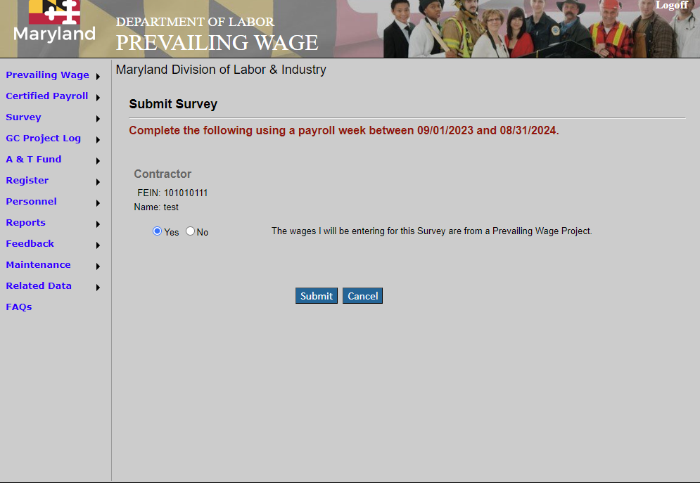
Getting Started
Use your credentials to log into Maryland’s Prevailing Wage website

Slide 21
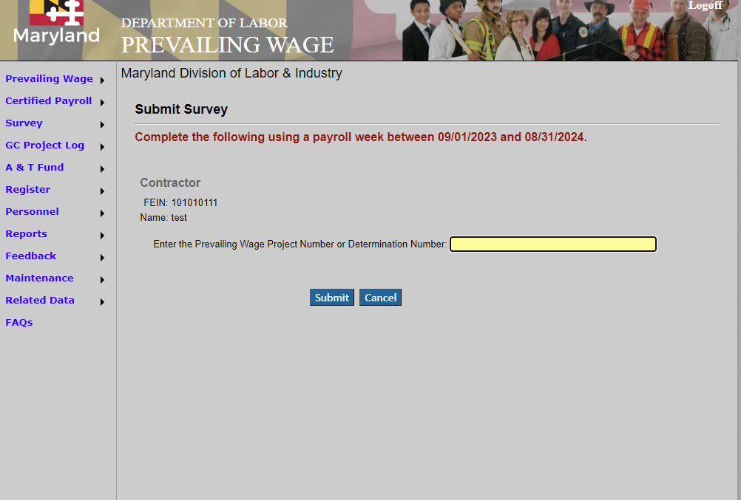
If you are entering data for a prevailing wage project, enter the determination number, then hit submit.

Slide 22
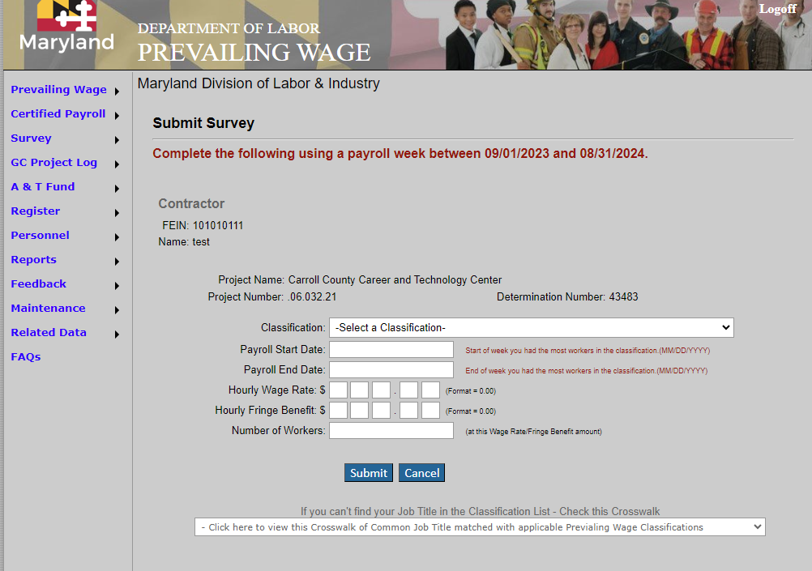
The project information will automatically populate. Next, select the classification.

Slide 23
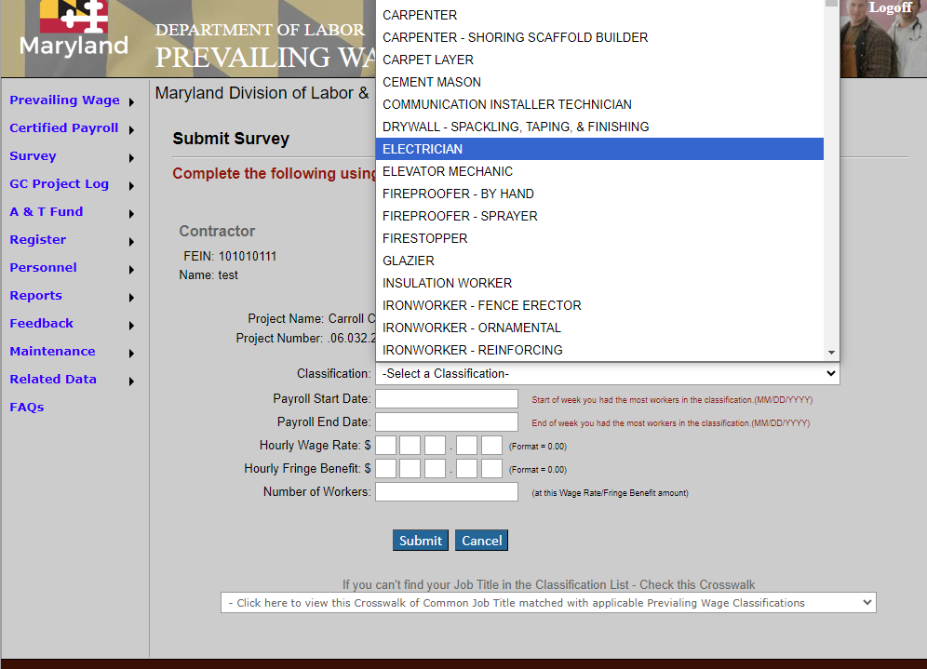
Use the dropdown menu to select a classification.

Slide 24
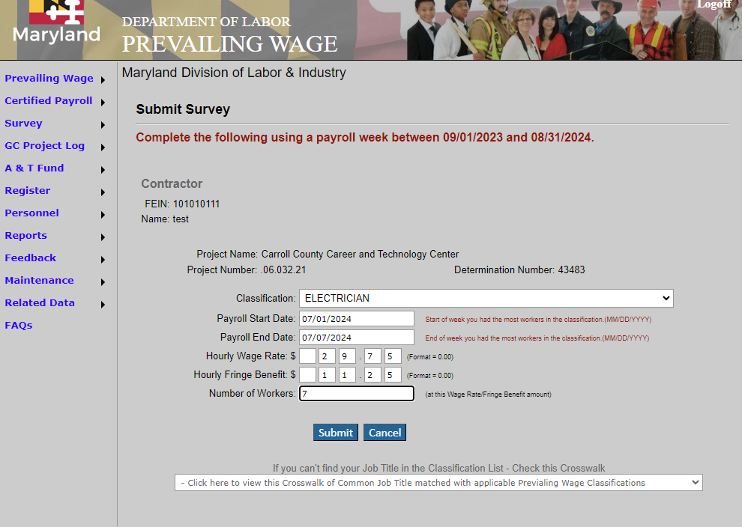
Enter the payroll dates, rates, and number of workers receiving the same wage and the same fringe rates in that classification in that week.

Slide 25
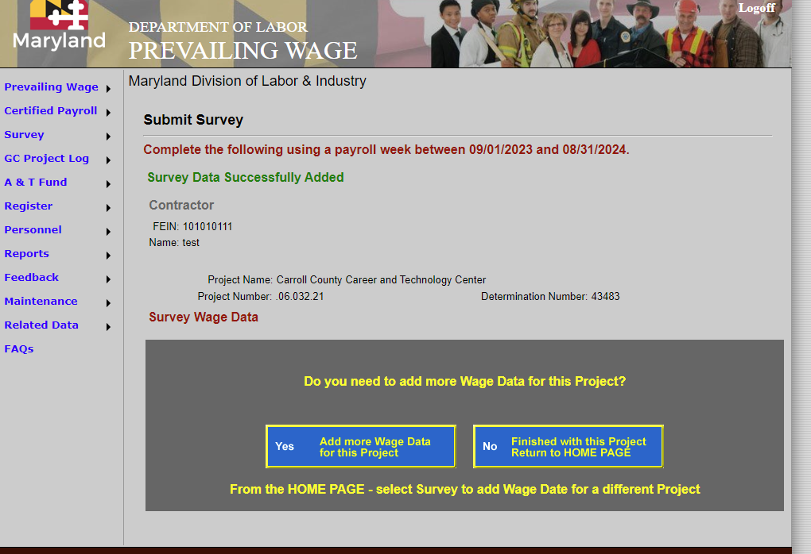
You’ll receive a success message.

Slide 26
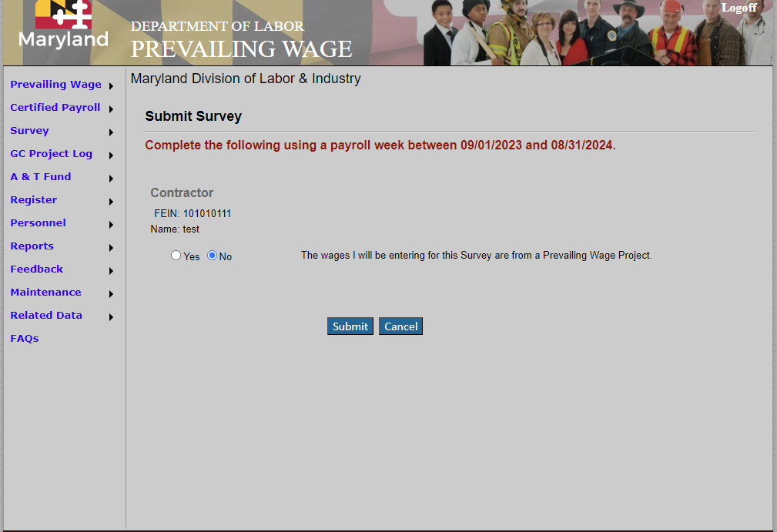
If your submission is not for a prevailing wage project, select no on the initial screen, and then hit “Submit.”

Slide 27
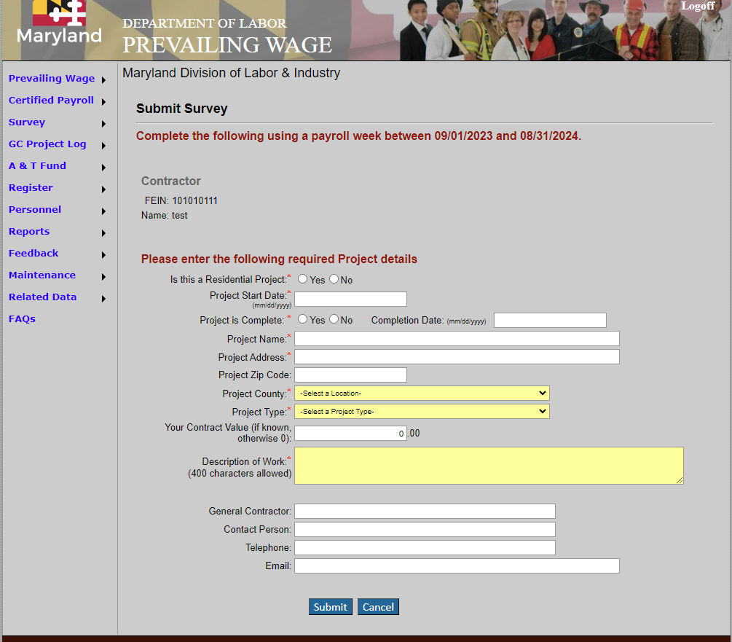
Enter your project details, including all required fields

Slide 28
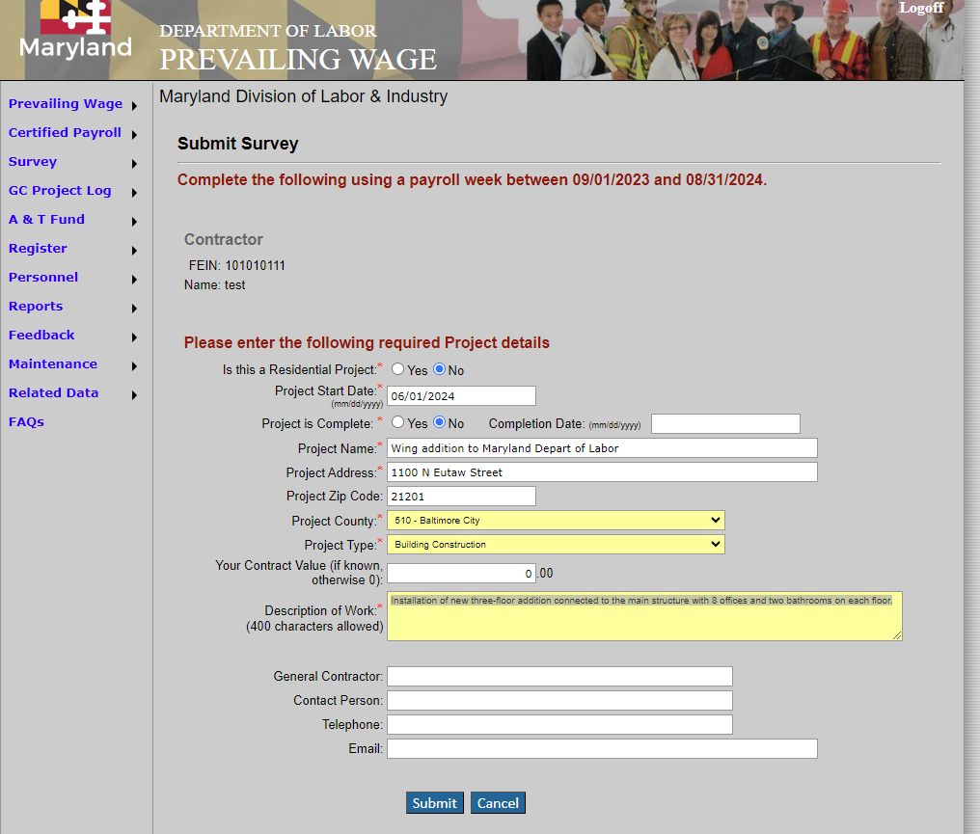
Required fields are marked with an asterisk.

Slide 29
Required fields are marked with an asterisk.

Slide 30
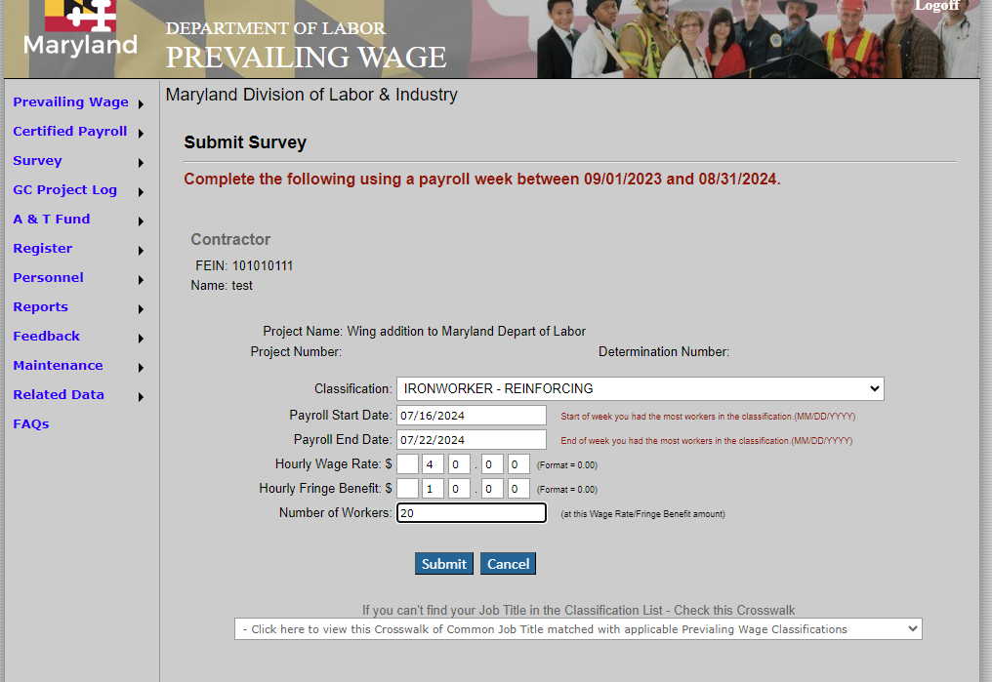
Select the classification, enter the payroll dates, enter the wage and fringe amounts, and enter the number of workers in the selected classification receiving those wage and fringe amounts during that payroll period. Hit submit.

Slide 31
If you don’t see your classification,
check the crosswalk

Slide 32
DOUBLE CHECK BEFORE YOU HIT SUBMIT!
Remember: submission means that you are attesting to the accuracy of the information!
You will receive a submission receipt when you successfully submit
If you make a mistake, please send your submission receipt, along with the correction or withdrawal request, to the Prevailing Wage email address
Retain all backup information so that you can produce it easily if your submission is selected for validation
Noncompliant, incomplete or inaccurate data, and data that the unit is unable to validate, will be excluded from consideration in the survey

Slide 33
RECAP:
The survey is open between September 1- October 31 at midnight.
Please carefully review the survey notice, FAQs and other information before submitting your data to make sure your submission complies with the rules - noncompliant data will be excluded
Your participation is encouraged! The survey is voluntary and the more submissions we receive, the more representative the rates paid in your area in the coming year

Slide 34
Questions? Contact us!
Division of Labor and Industry
Prevailing Wage Unit
10946 Golden West Drive Suite 160
Hunt Valley, MD 21031
410-767-2342
e-mail: dldliprevailingwage-labor+survey@maryland.gov
Allen Griffith, Unit Supervisor

Slide 35
Thank you for participating in the annual survey!

