Slide 1

Oral Interpretation Services Best Practices
Augustin Ntabaganyimana (DHS)
Hannah Stocks (IRC)
Sehine Haile (IRC)

Slide 2
Maryland Department of Budget and Management
Statewide Foreign Language Interpretation/ Translation Services (FLITS)

Slide 3

TELEPHONIC INTERPRETATION VENDOR
Language Line Solutions is contracted with the State of Maryland for telephonic interpretation.
Telephonic interpretation services allow staff to serve a customer through the assistance of an external, third party interpreter. Staff can relay their conversations and questions in English over the telephone and their speech is interpreted and spoken back to a client in their preferred language.

Slide 4

IN-PERSON INTERPRETATION VENDOR
Ad Astra is contracted with the State of Maryland to provide in-person interpretation services.
In-person interpretation is a real-time, face-to-face oral interpretation service option that allows customers to receive information in their preferred language with incorporation of “cultural and syntactical context.” Service is delivered on site by a certified interpreter.

Slide 5

TRANSLATION SERVICES VENDOR
Schreiber Translations, Inc. (Schreiber) is contracted with the State of Maryland to provide written translation services.
Translation services allow for documents and print material to be converted to a customer’s language.

Slide 6
ELIGIBLITY FOR SERVICE AND CONTACT
Procured contracts to provide Maryland State agencies, local governments, counties, municipalities, nonprofit organizations, etc. with interpretation and translation services
FLITS website: http://www.dbm.maryland.gov/proc-contracts/Pages/statewide-contracts/LanguageContractHome.aspx
State staff should contact the Language Access Coordinator in their area with questions
  DHS: Augustin Ntabaganyimana
  DLLR (DWDAL): Lauren Gilwee
  DLLR (DUI): Leroy Cox and Wayne Cooper

Slide 7
Working Effectively with an Interpreter
International Rescue Committee
Maryland

Slide 8
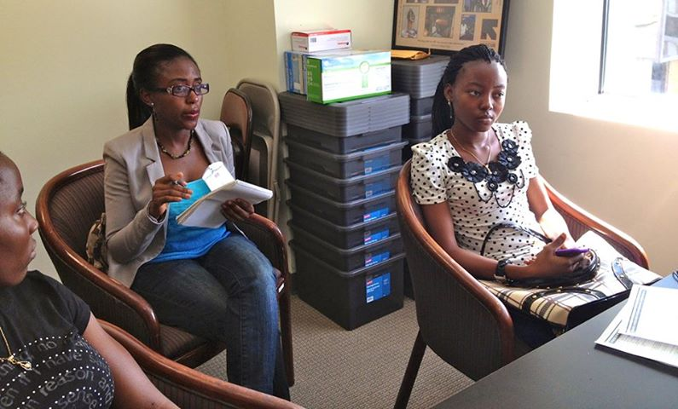
Training Objectives
Define Title VI and when to provide interpretation
Learn to work effectively with an interpreter
Understand the role of an interpreter
Discuss strategies for correcting an untrained interpreter

Slide 9
Interpreter vs. Translator
  Interpreting:
Rendering a message orally (or in a signed language) from one language into another
  Translating:
  Rendering a written text from one language to another in writing
  **An interpreter is not necessarily a qualified translator**

Slide 10
Fluency PSA
https://www.youtube.com/watch?v=fRaMKl5C_fI

Slide 11

Title VI & Language Access Laws
“No person in the United States shall, on ground of race, color, or national origin, be excluded from participation in, or be denied the benefits of, or be subjected to discrimination under any program or exercise receiving federal financial assistance."

Slide 12
Executive Order 13166
Agencies must provide meaningful access to services. LEP clients should receive services consistent with the organizational standard without unduly burdening the fundamental mission of the agency.
Signed in 2000.

Slide 13

How to work with an interpreter
CRASH COURSE!

Slide 14
Where do you position the interpreter?
Please vote!
Choice C
Phone
Choice A
Choice B
Provider
Client
Interp
Interpreter
Provider
Client
Choice D
Provider
Client
Provider
Phone
Client

Slide 15
Where do you position the interpreter?
Choice C
Phone
Choice A
Choice B
Provider
Client
Interp
Interpreter
Provider
Client
Choice D
Provider
Client
Provider
Phone
Client

Slide 16

How to work with an interpreter– and WHY?
Look at and speak directly to the client – not the interpreter!
Use first person
  Ex: “What are you taking for the pain” NOT “can you ask her what she is taking for the pain?”
Ask the client for clarification

Slide 17
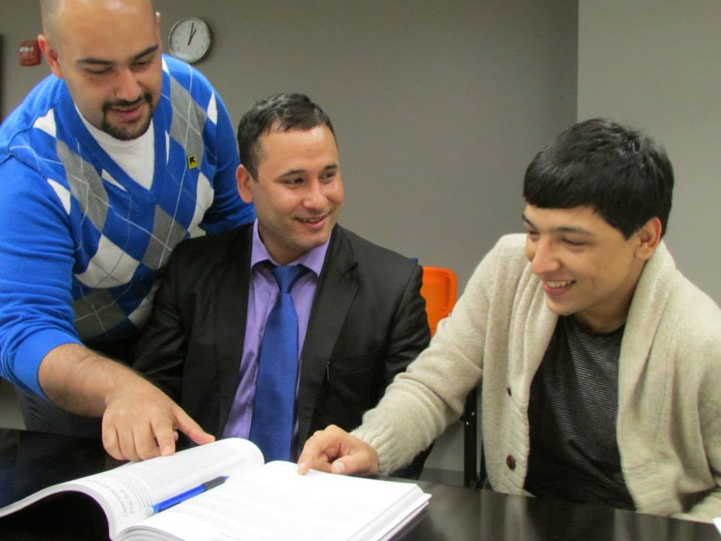
How to work with an interpreter – and WHY?
Speak slowly and pause every 2-3 sentences
No side-conversations with the interpreter
Check for understanding with the client
  EX: “When and where will I see you again?,” NOT “Did you understand?”
Do not ask the interpreter about the client or the client’s culture. Ask the client.

Slide 18
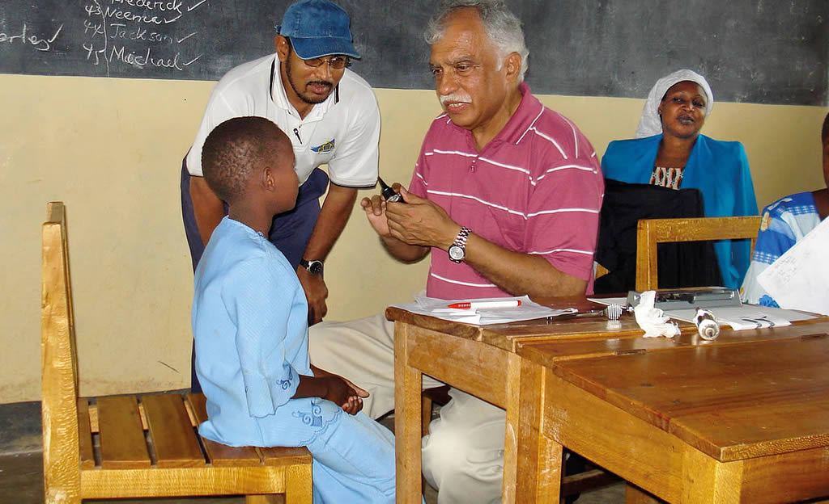
Do not use children as interpreters!
Video: http://www.youtube.com/watch?v=8fVR75ko0hM&list=PL4BB0BF3D6577B93C

Slide 19
Correcting and guiding your interpreter

Slide 20
Correcting and guiding your interpreter
YOU manage the quality of your interpreted session
Remind your trained interpreter of expectations and standards as necessary
Set your untrained interpreter up for success

Slide 21
Scenarios:
The interpreter appears to be interpreting long sentences or segments while you ask very short questions. What do you do? What do you say?
The client keeps turning to the interpreter and apparently asking questions. What do you do? What do you say?
The client and interpreter know each other well (or seem to know each other well). What do you do? What do you say?
The telephonic interpreter starts giving you advice on how to help the client. What do you do? What do you say?

Slide 22
Summary
Interpretation services allow your organization to serve all qualified beneficiaries. Good interpretation promotes self-sufficiency.
The interpreter’s job is to provide language services. They are not a cultural advisor or an expert on the client.
The provider should focus on meeting and forming a working relationship with the client.
It is the responsibility of the provider to set the interpreter and client up for success.

Slide 23
Resources:
NCIHC Ethics and Standards of Practice for Interpreters
Quick Tips for Working with Interpreters
Baltimore’s Short (3 Hour) Interpreter Training
This Presentation
Key Terms for IRC Interpreters (Translated)
More information on Title VI: http://www.justice.gov/crt/about/cor/Pubs/eolep.php
DOJ Complaint Form: http://www.justice.gov/crt/about/cor/complaint.php

Slide 24
Thank you.

Slide 25
Breaking Down the Language Barrier
US DOJ
http://www.youtube.com/watch?v=qaVKy-2HWIo&list=PL4BB0BF3D6577B93C
Please watch from minute 18:30-19:30 OR from minute 0-1:18 OR 0-5:10
http://gofluently.com/fluency-psa.htm

Slide 26
Legal Services of New Jersey Video Clip (Optional)
https://www.youtube.com/watch?v=pVm27HLLiiQ
(watch from :30)

